Slide 1
Lecture 6
Topics
  Combinational Logic Circuits
    Graphic Symbols (IEEE and IEC)
    Switching Circuits
    Analyzing IC Logic Circuits
    Designing IC Logic Circuits
    Detailed Schematic Diagrams
    Using Equivalent Symbols

Slide 2
Combinational Logic Circuits
Combinational Logic
  Outputs depend only upon the current inputs (not previous “state”)
Positive Logic
  High voltage (H) represents logic 1 (“True”)
  “Signal BusGrant is asserted High”
Negative Logic
  Low voltage (L) represents logic 1 (“True”)
  “Signal BusRequest# is asserted Low”

Slide 3
Graphic Symbols

Slide 4
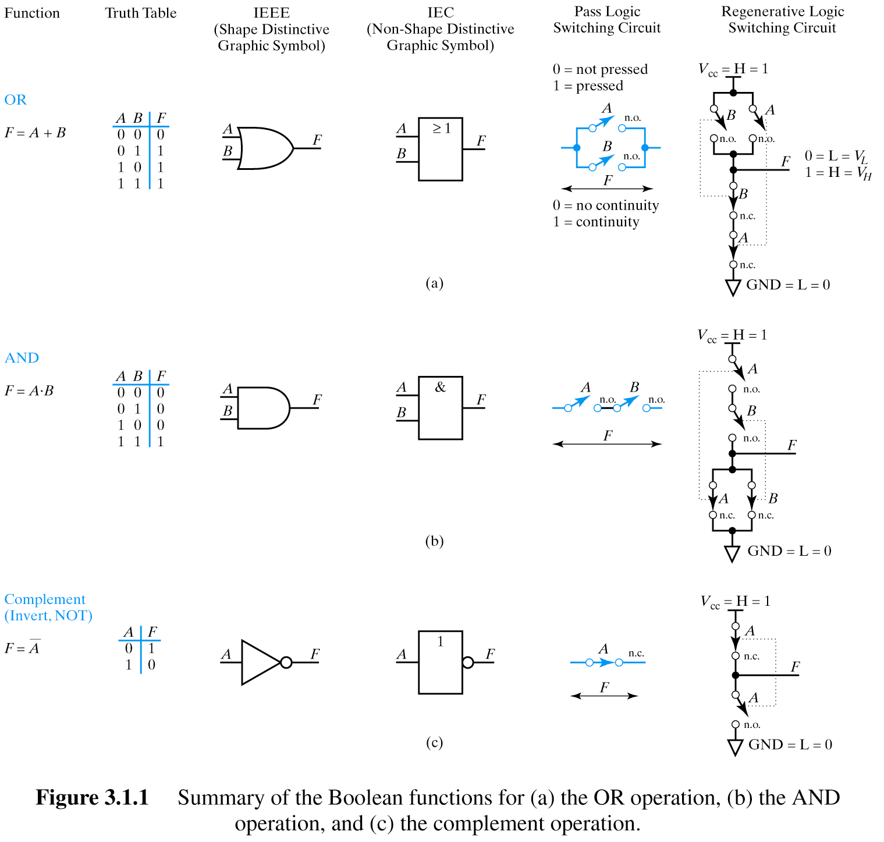
IEEE: Institute of Electrical
and Electronics Engineers
IEC: International Electro-
technical Commission

Slide 5
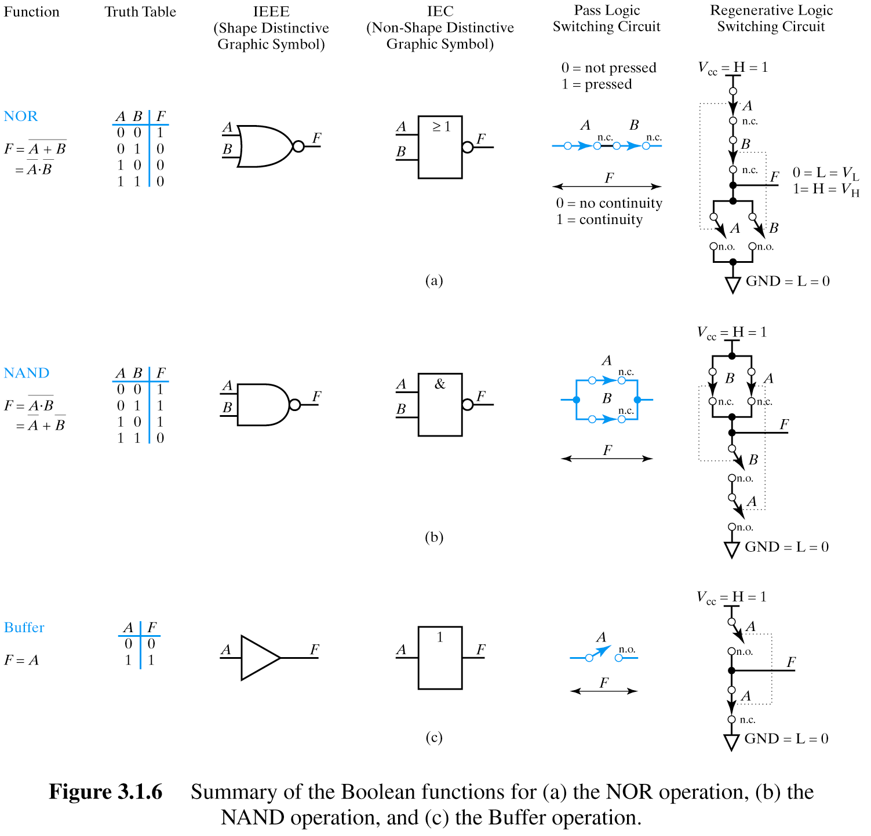

Slide 6
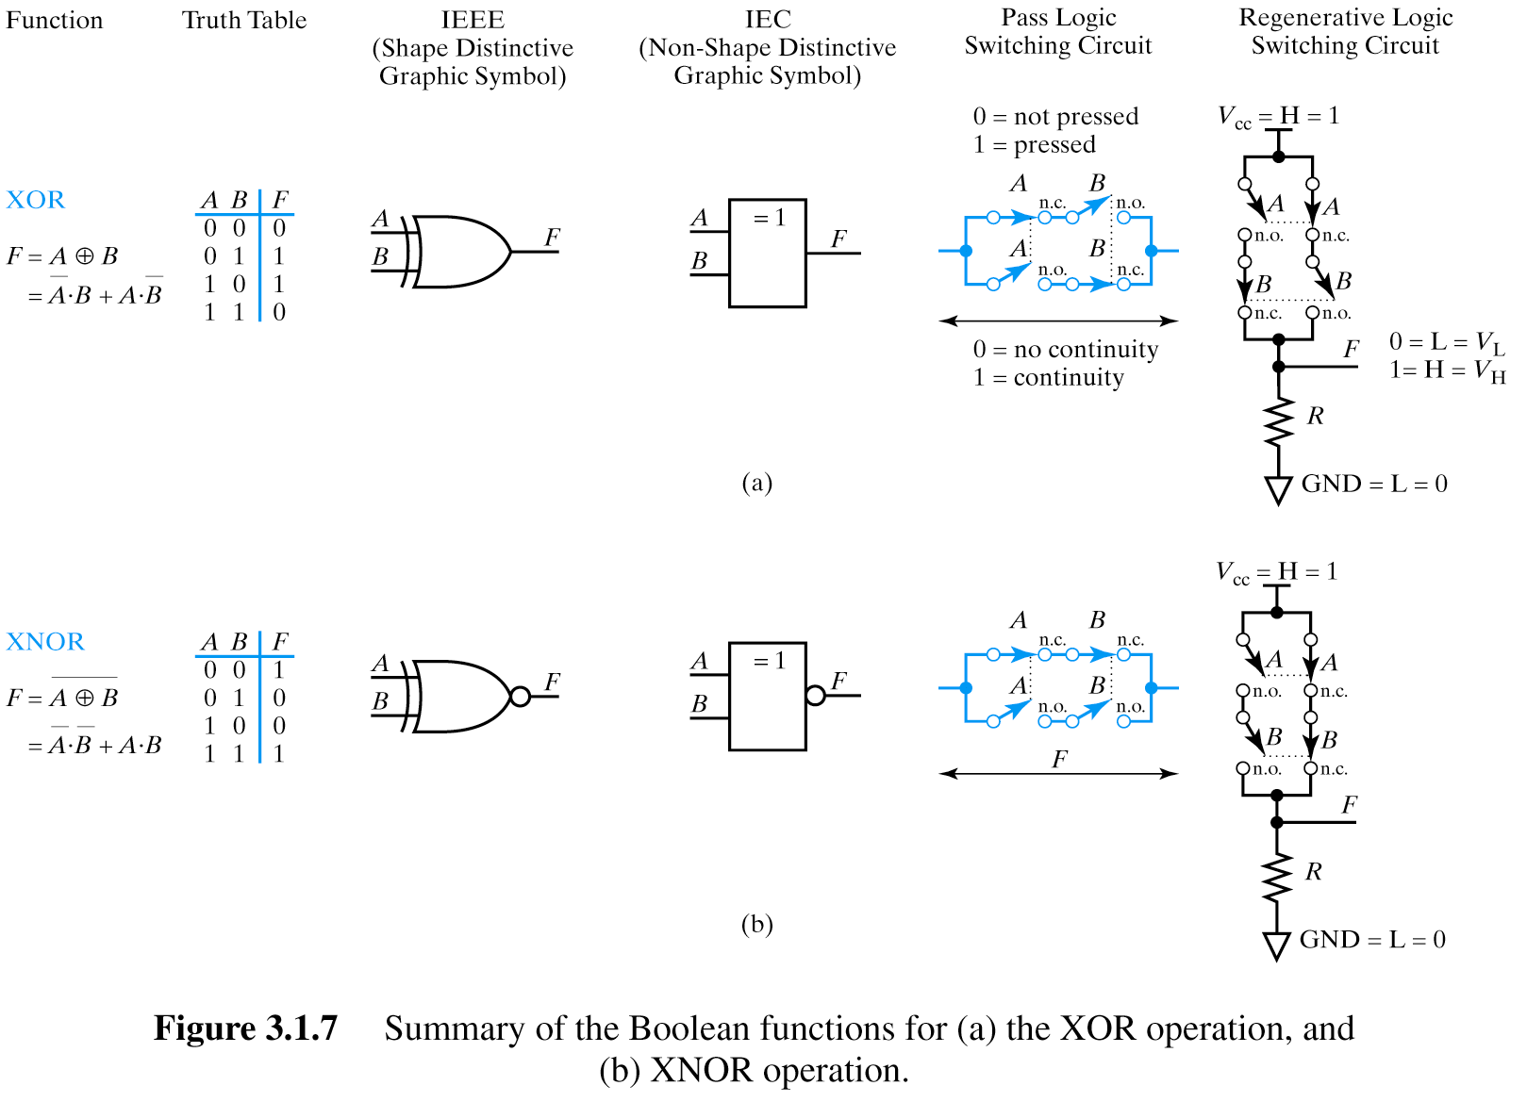

Slide 7
Pass Logic versus Regenerative Logic

Slide 8
OR gate using Pass Logic and using Regenerative Logic
n.o. = normally open
n.c. = normally closed
These regenerative logic switching circuits that we’ll be seeing are actually very close to the way real CMOS ICs are implemented and can be a useful model for us without getting into the details of how the transistors actually work.
In particular, note the voltage differential and direction of current flow!

Slide 9
AND gate using Pass Logic and using Regenerative Logic
n.o. = normally open
n.c. = normally closed

Slide 10
NOT gate using Pass Logic and using Regenerative Logic
n.o. = normally open
n.c. = normally closed

Slide 11
NOR gate using Pass Logic and using Regenerative Logic
n.o. = normally open
n.c. = normally closed

Slide 12
NAND gate using Pass Logic and using Regenerative Logic
n.o. = normally open
n.c. = normally closed

Slide 13
Buffer gate using Pass Logic and using Regenerative Logic
n.o. = normally open
n.c. = normally closed

Slide 14
XOR gate using Pass Logic and using Regenerative Logic
n.o. = normally open
n.c. = normally closed

Slide 15
XNOR gate using Pass Logic and using Regenerative Logic
n.o. = normally open
n.c. = normally closed

Slide 16
All Possible
Two-Variable Functions

Slide 17
All Possible Two Variable Functions
Question: How many unique functions of two
variables are there?
Recall earlier question…

Slide 18
Truth Tables
Question: How many rows are there in a truth table
for n variables?
2^{n}
0
1
2
3
.
.
.
63
B₅ B₄ B₃ B₂ B₁ B₀ F
0 0 0 0 0 0 0
0 0 0 0 0 1 1
0 0 0 0 1 0 1
0 0 0 0 1 1 0
.
.
.
1 1 1 1 1 1 1
As many rows as unique combinations
of inputs
Enumerate by counting in binary
2⁶ = 64

Slide 19
Two Variable Functions
Question: How many unique combinations of 2^{n} bits?
n
0
1
2
3
.
.
.
63
B₅ B₄ B₃ B₂ B₁ B₀ F
0 0 0 0 0 0 0
0 0 0 0 0 1 1
0 0 0 0 1 0 1
0 0 0 0 1 1 0
.
.
.
1 1 1 1 1 1 1
2
2
Enumerate by counting in binary
2⁶ = 64
2⁶⁴
Notes:
Just as we enumerated the number of rows in the truth table by “counting” in binary, we can enumerate all the unique possible functions by “counting” the vector’s possible values in binary.

Slide 20
All Possible Two Variable Functions
Question: How many unique functions of two
variables are there?
B₁ B₀ F
0 0 0
0 1 1
1 0 1
1 1 0
2² = 4 rows
4 bits
Number of unique 4 bit words = 2⁴ = 16

Slide 21
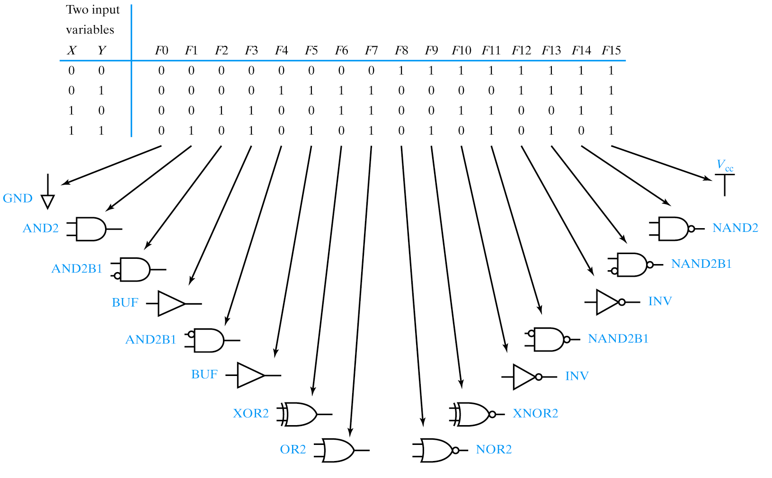

Slide 22
Analyzing Logic Circuits

Slide 23
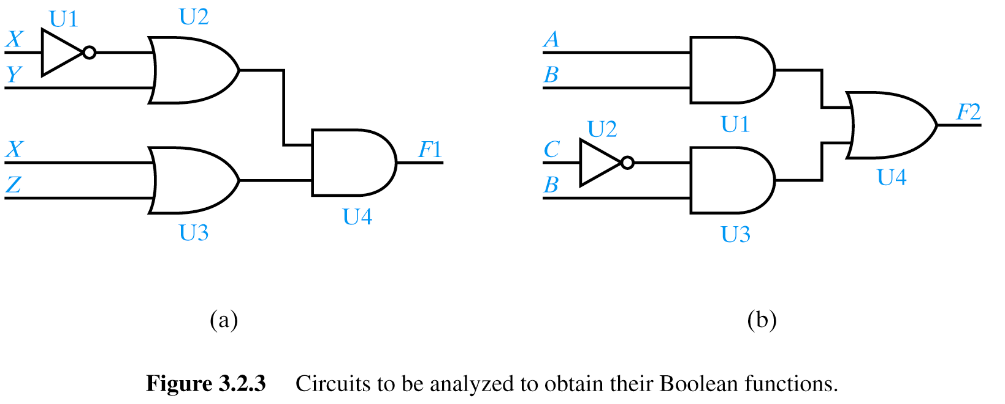
Analyzing Logic Circuits
X
X + Y
(X + Y)⋅(X + Z)
X + Z
Reference Designators (“Instances”)

Slide 24
Analyzing Logic Circuits
A⋅B
A⋅B + B⋅C
C
B⋅C

Slide 25
Designing Logic Circuits

Slide 26
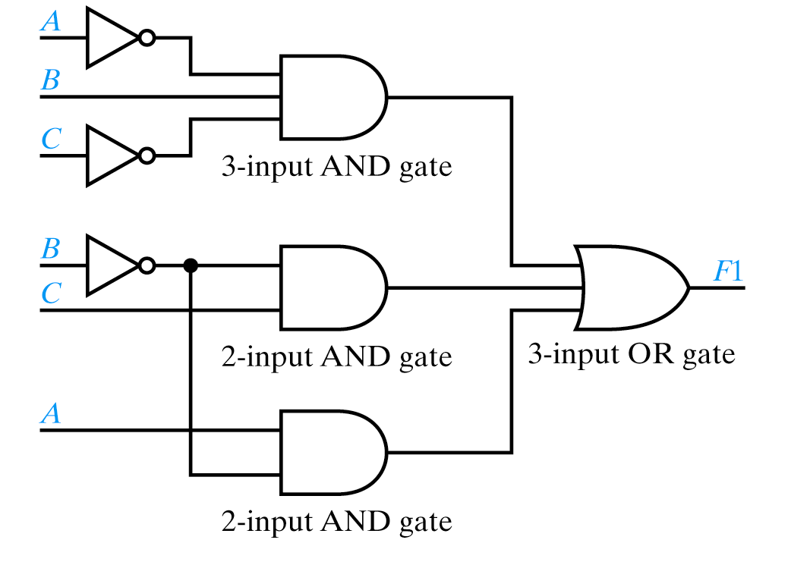
Designing Logic Circuits
F1 = A⋅B⋅C + B⋅C + A⋅B
SOP form with 3 terms → 3 input OR gate

Slide 27
Designing Logic Circuits
F1 = A⋅B⋅C + B⋅C + A⋅B
Complement already available

Slide 28
Some Terminology
F1 = A⋅B⋅C + B⋅C + A⋅B
Signal line – any “wire” to a gate input or output

Slide 29
Some Terminology
F1 = A⋅B⋅C + B⋅C + A⋅B
Net – collection of signal lines which are connected

Slide 30
Some Terminology
F1 = A⋅B⋅C + B⋅C + A⋅B
Fan-out – Number of inputs an IC output is driving
Fan-out of 2
Notes:
Book confused “fan-out” with “maximum fan-out”

Slide 31
Some Terminology
F1 = A⋅B⋅C + B⋅C + A⋅B
Fan-in – Number of inputs to a gate
Fan-in of 3
Notes:
Book confused “fan-out” with “maximum fan-out”

Slide 32
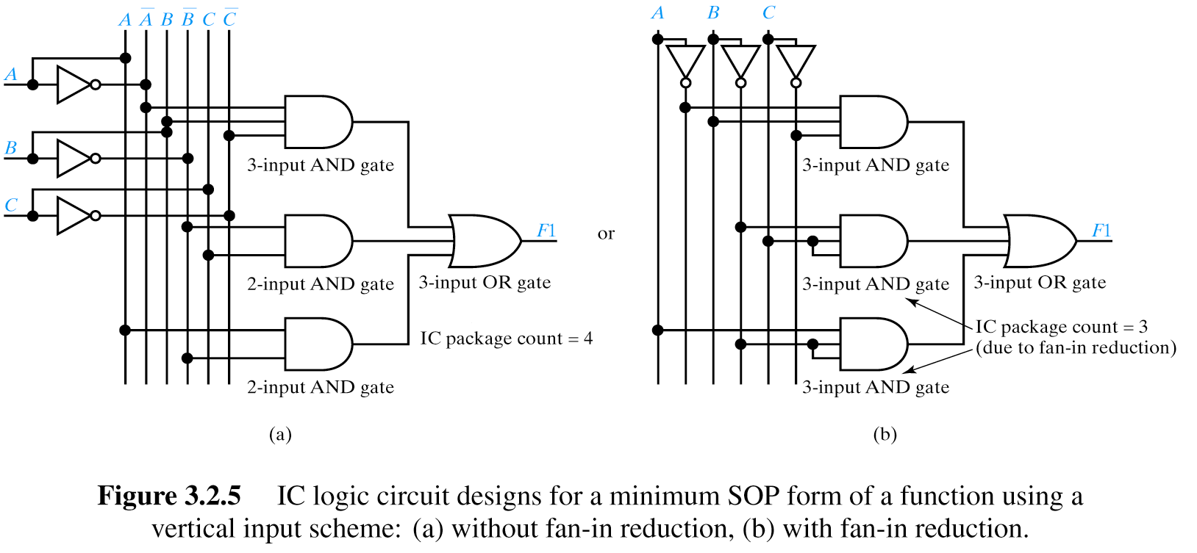
Vertical Layout Scheme – SOP Form

Slide 33
Vertical Layout Scheme – SOP Form

Slide 34
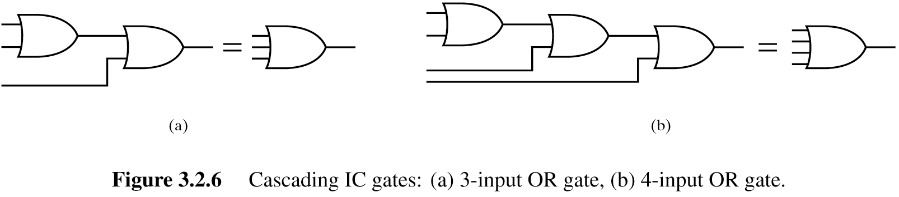
>2 Input OR Gates Not Available for all IC Technologies
Solution: “Cascading” gates

Slide 35
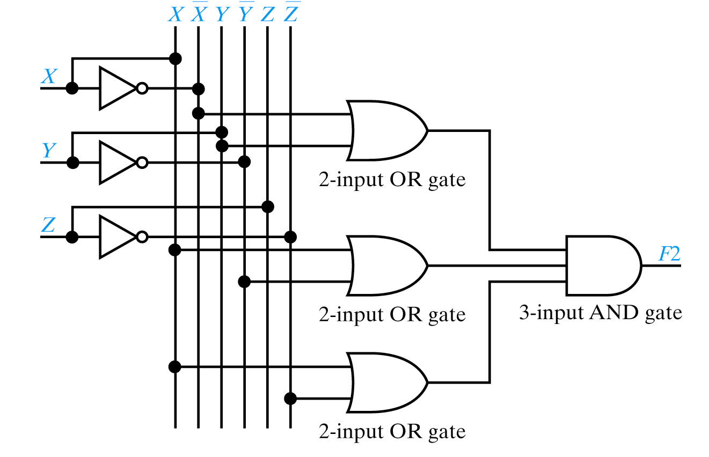
Vertical Layout Scheme – POS Form
F2 = (X+Y)⋅(X+Y)⋅(X+Z)

Slide 36
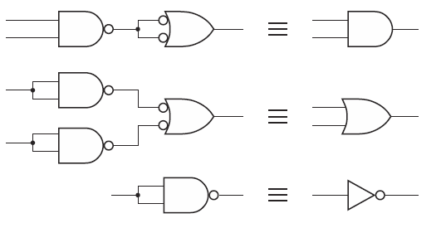
Designing Using DeMorgan Equivalents
Often prefer NAND/NOR to AND/OR when using real ICs
  NAND/NOR typically have more fan-in
  NAND/NOR “functionally complete”
  NAND/NOR usually faster than AND/OR

Slide 37
NAND and NOR gates

Slide 38
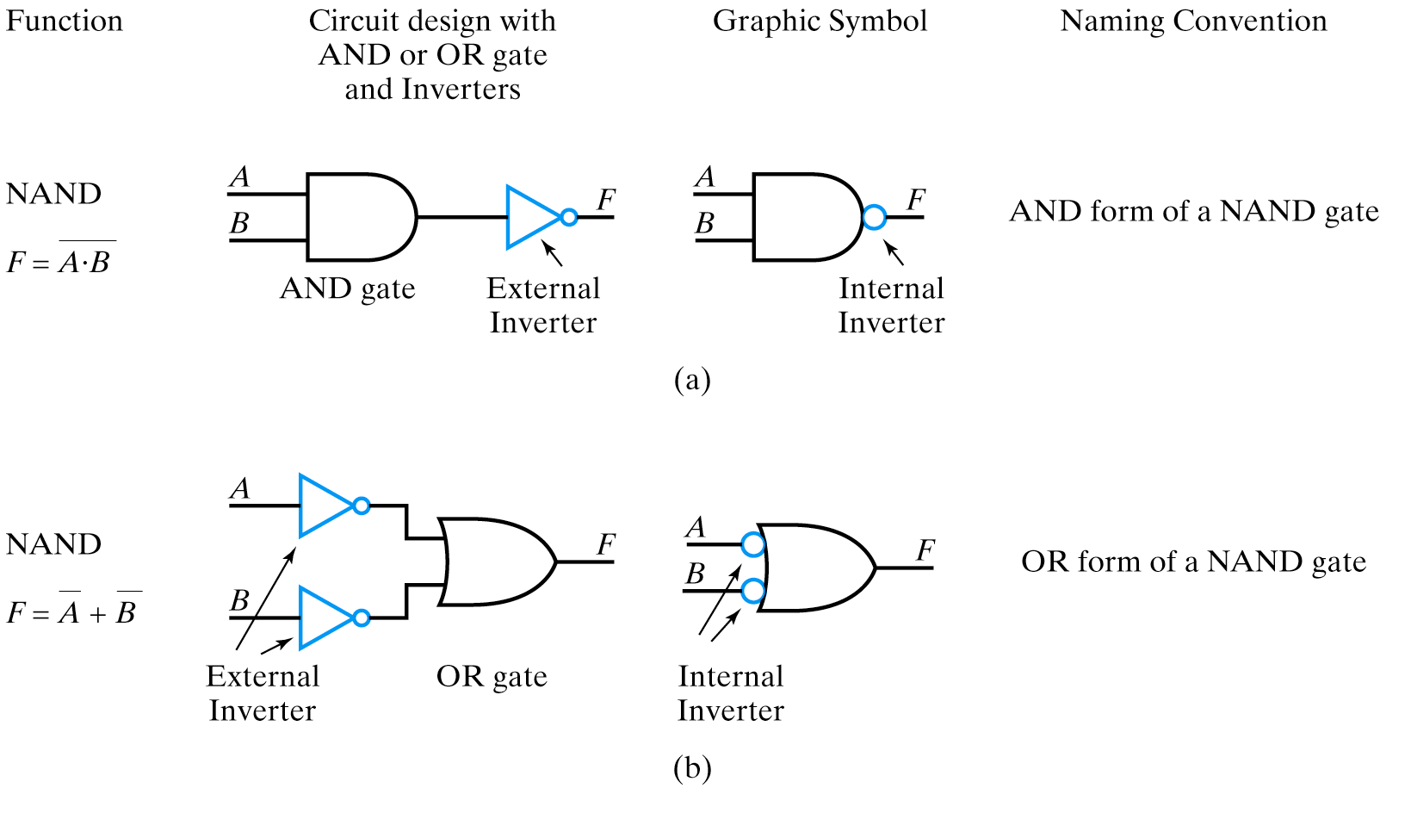
AND/OR forms of NAND
DeMorgan’s Theorem

Slide 39
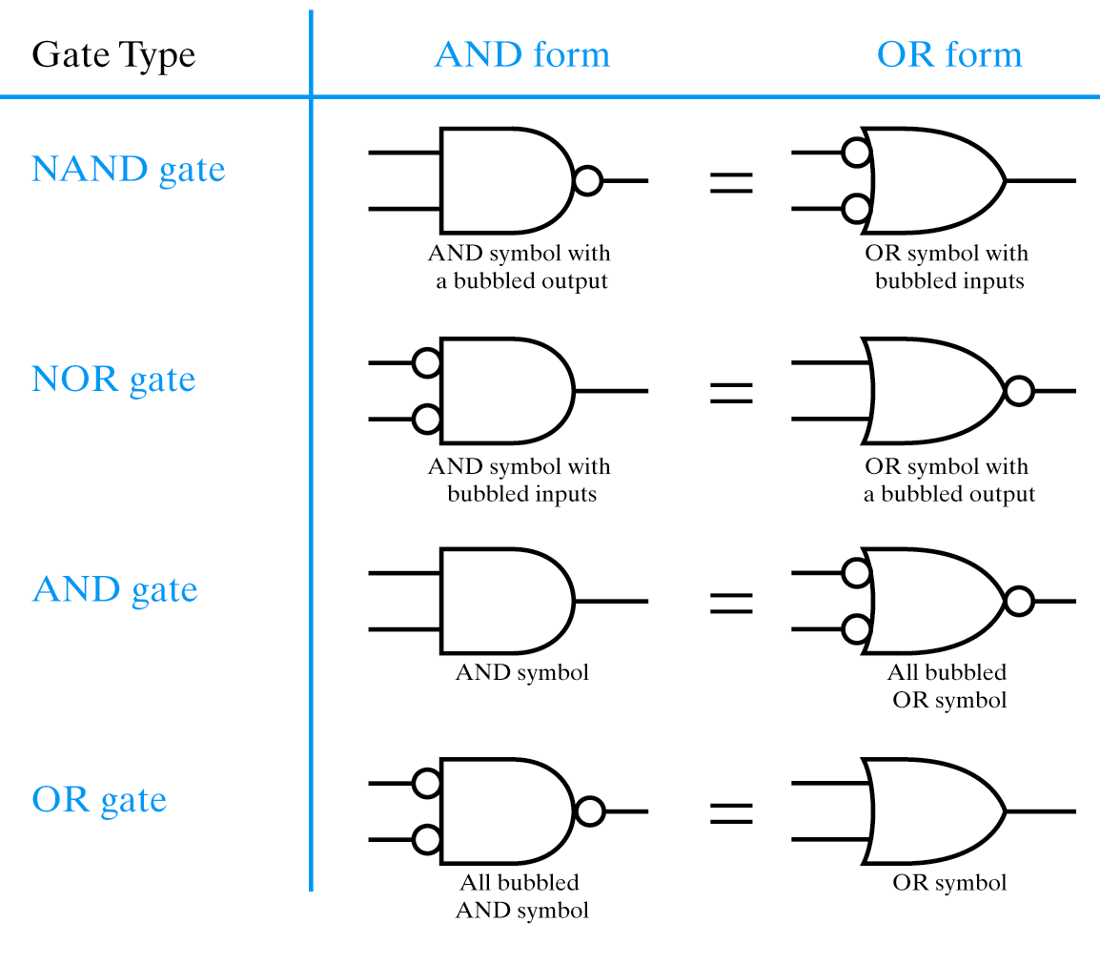
Summary of AND/OR forms
Change OR to AND
“Complement” bubbles

Slide 40
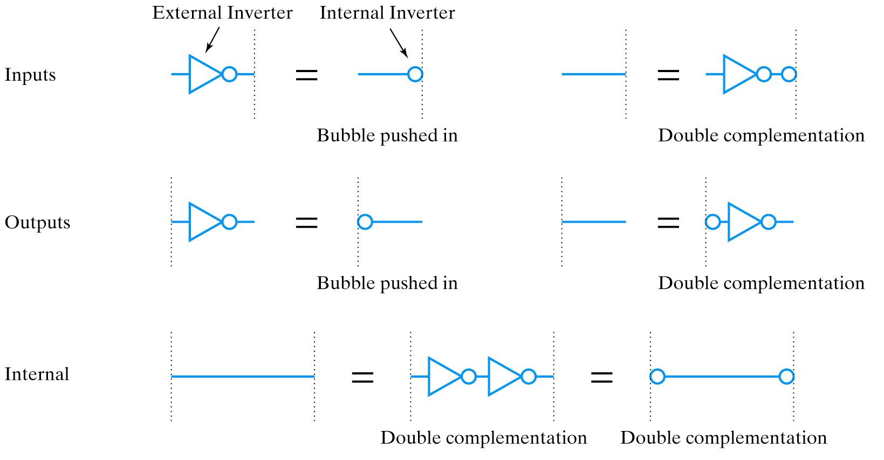
Equivalent Signal Lines

Slide 41
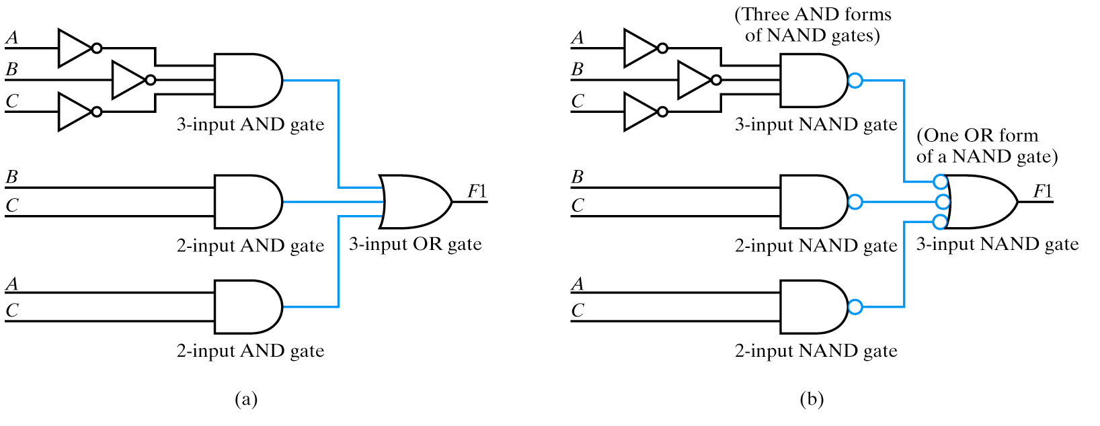
NAND/NAND Example

Slide 42
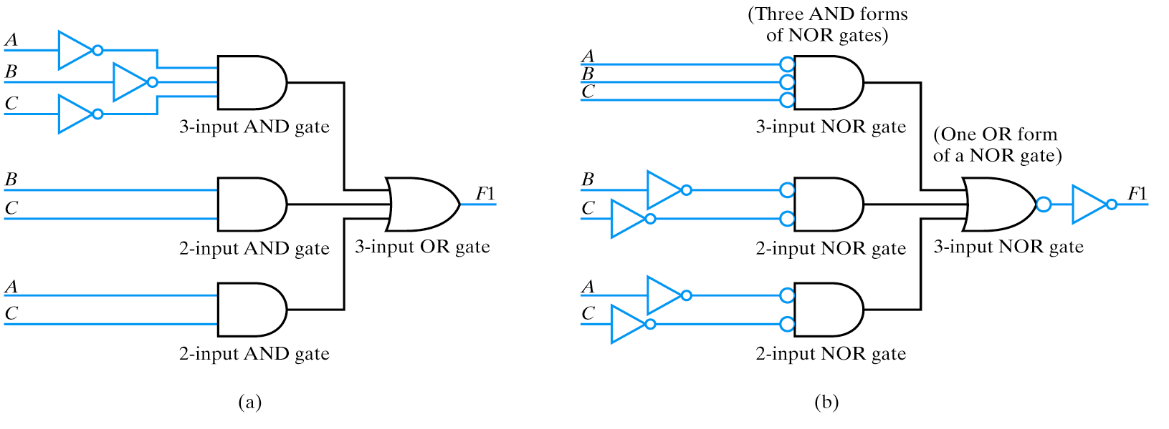
NOR/NOR Example

Slide 43
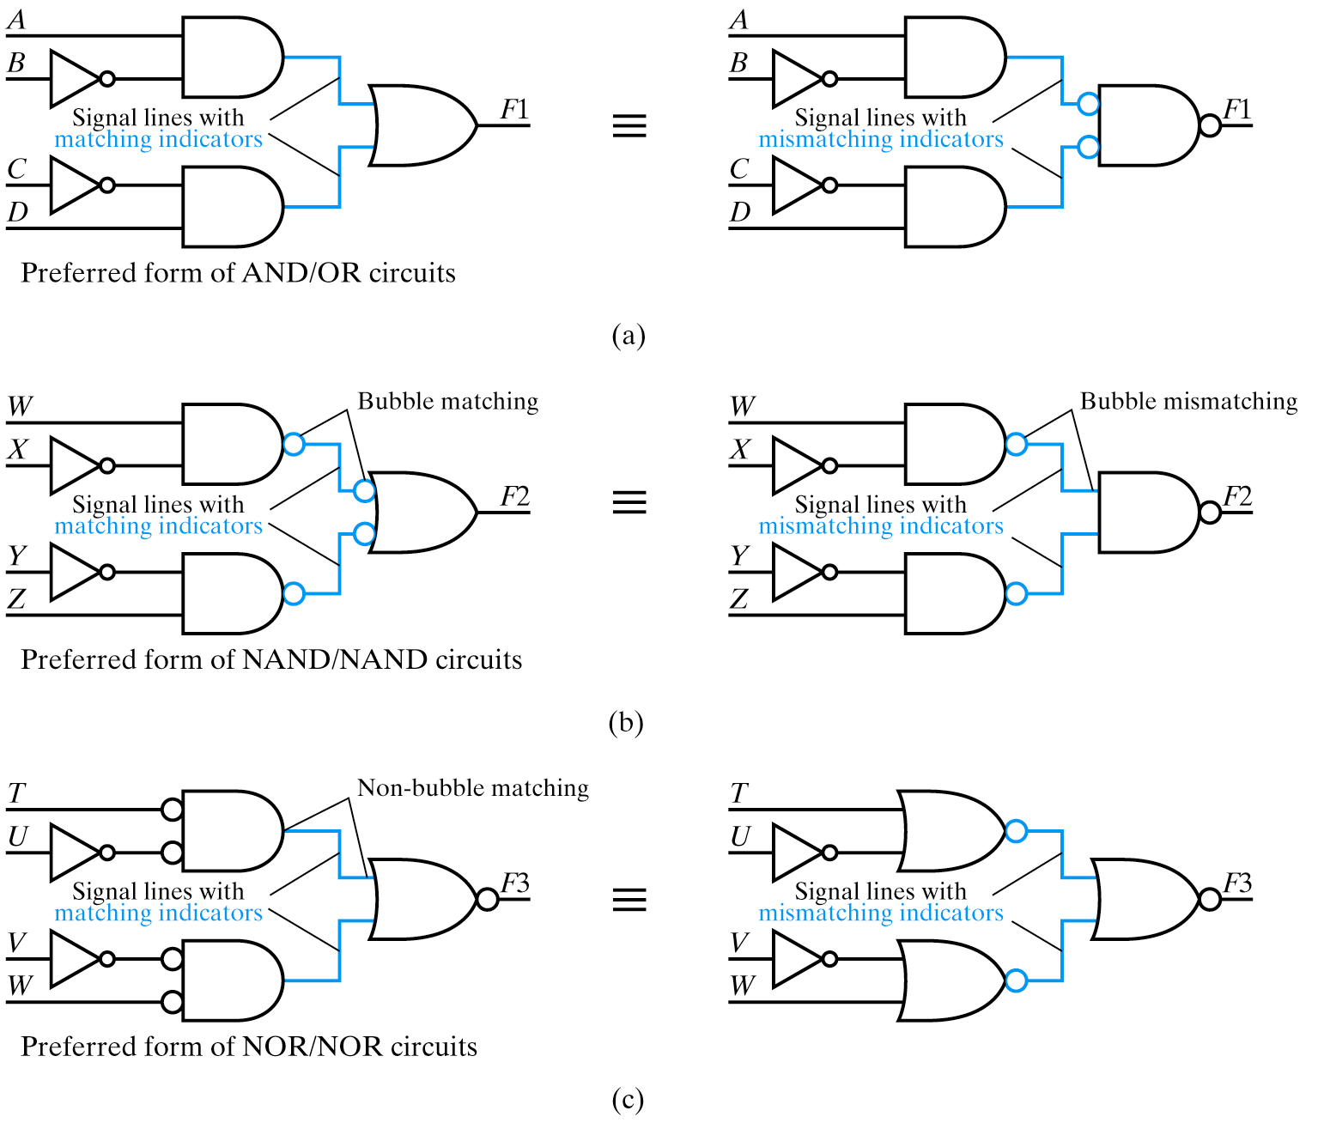

Slide 44
Sources
Prof. Mark G. Faust
John Wakerly

